Slide 1

Dr.seq2
[Step1_Mapping]
——Parameters in config file

Slide 2
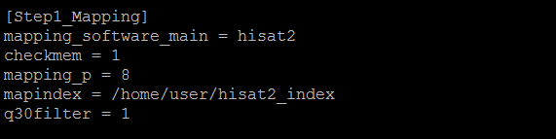
Parameters in [Step1_Mapping]

Slide 3
Parameters in [Step1_Mapping]
mapping_software_main = hisat2
#name of your mapping software, choose from hisat2, STAR and bowtie2
checkmem = 1
#only take effect when mapping_software_main = STAR.Dr.seq2 will check your total memory to make sure its greater 40G if you choose STAR as mapping tool.

Slide 4
Parameters in [Step1_Mapping]
mapping_software_main = hisat2
#name of your mapping software, choose from hisat2, STAR and bowtie2
checkmem = 1
#only take effect when mapping_software_main = STAR.Dr.seq2 will check your total memory to make sure its greater 40G if you choose STAR as mapping tool.

Slide 5
Parameters in [Step1_Mapping]
mapping_p = 8
#Number of alignment threads to launch alignment software
mapindex = /home/user/hisat2_index
#Mapping index of your alignment tool
q30filter = 1
#Use q30 criteria (Phred quality scores) to filter reads in sam file, set this parameter to 1(default) to turn on this option, set 0 to turn off. Default is 1

Slide 6
Parameters in [Step1_Mapping]
mapping_p = 8
#Number of alignment threads to launch alignment software
mapindex = /home/user/hisat2_index
#Mapping index of your alignment tool
q30filter = 1
#Use q30 criteria (Phred quality scores) to filter reads in sam file, set this parameter to 1(default) to turn on this option, set 0 to turn off. Default is 1

Slide 7
Parameters in [Step1_Mapping]
mapping_p = 8
#Number of alignment threads to launch alignment software
mapindex = /home/user/hisat2_index
#Mapping index of your alignment tool
q30filter = 1
#Use q30 criteria (Phred quality scores) to filter reads in sam file, set this parameter to 1(default) to turn on this option, set 0 to turn off. Default is 1

